Slide 1
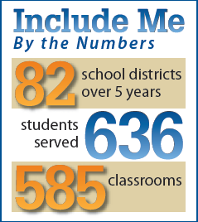
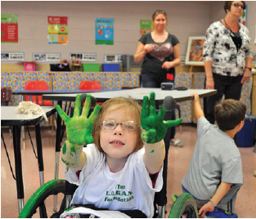
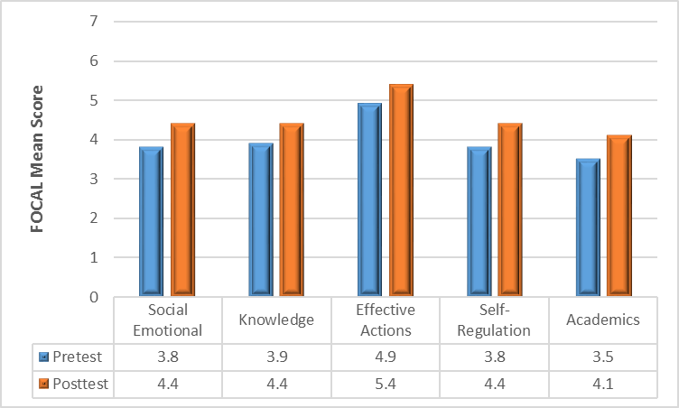
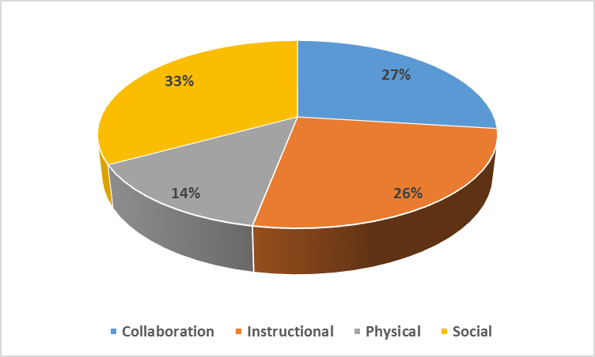
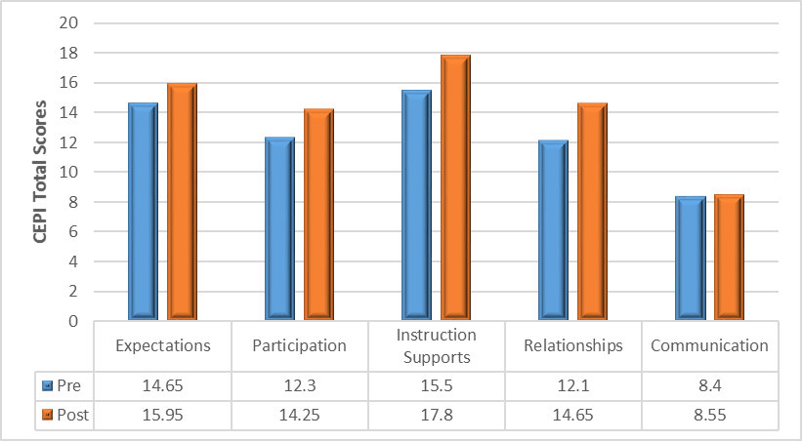
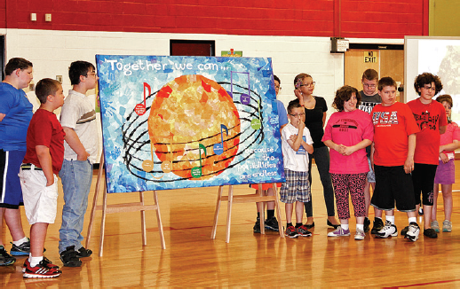
“Include Me educated me about the importance of inclusion as my child strives to reach her potential and to live, work and succeed.
SPECS for Include Me (IM): Evidence-based Research for the Impact of Mentoring on Inclusive Instructional Practices
Stephen J. Bagnato, Ed.D, NCSP, Rita Cheskiewicz, Pat Hozella,
Tracy Larson, M. Ed., CAGS, NCSP, Jennifer Salaway, Ph.D, Kristyn Brier, BA
What is Include Me (IM)?
IM is a statewide initiative to mentor teachers to support and include children with significant disabilities into regular classrooms using “best instructional practices”.
IM facilitates the development of parent-school-community partnerships for effective and successful inclusion.
“We have been very happy with Sofia’s success so far. It is like night and day. I truly feel that the ‘Include me from the Start’ program was the key for this drastic change at school.”
What are the most effective elements of the IM mentoring model?
Trusting, confident, and ongoing relationships between mentors and mentees.
Weekly, face-face teacher mentoring supplemented by virtual modes and resources
In-vivo teacher mentoring and modeling within natural classroom activities
Individualized and collaboratively designed teaching goals linked to tangible strategies (SaS) which foster inclusive instruction
Ongoing observation assessment of students within classroom learning tasks linked to functional and academic goals
High teacher expectations for all students to succeed
Mentoring to nurture the trust and engagement between parents and teachers
How have teachers benefited from IM mentoring?
➜ Inclusive practices improved significantly during IM mentoring.
➜ Diverse teachers in rural and urban districts showed similar patterns of skill acquisition in inclusion strategies through mentoring
➜ Significant teacher skill gains are apparent in all instructional domains, particularly on: adaptation, instructional supports, relationships, and membership/participation.
➜ Effectiveness was marked by prominent gains in the use of diverse inclusion supports: physical, social-behavioral, and instructional adaptations
➜ Teachers receiving IM mentoring demonstrated the use of quality inclusion practices that matched or exceeded that of teachers in national studies
➜ IM fostered teacher’s increased expectation for their children’s progress, which was associated with significant child progress
Exhibit 5: Average progress for children in grades 1-12 on the Functional Outcomes Classification of Assets for Learners (FOCAL)
Which strategies promote inclusion?
➜ Weekly and intensive classroom-based consultations
➜ Face-face and virtual consultation
➜ Target specific inclusion strategies in the SaS Toolkit (Supplementary Aides and Support)
➜ Higher use of inclusion strategies results in higher student progress in academic and behavioral settings
➜ The trusting relationship between the teacher and mentor is the foundation for effectiveness
How have parents and children benefited from IM mentoring?
➜ Parents appreciated the objective, third party perspective of the consultant
➜ Parents reported the positive impact consultants had in supporting them in the inclusion process
➜ Children with severe disabilities in Grades K and 1 showed significant progress in social and behavioral competencies
➜ Children with severe disabilities in Grades 1-12 showed significant progress in such areas as Knowledge, Self-Regulation and Academic Competencies
➜ Child progress was socially noticeable & generalizable across both classroom and home settings
➜ Increased teacher expectations fostered child engagement in overall learning activities
Exhibit 8: Percent allocation of inclusion strategies across SAS Categories over the 5 years of IM
Exhibit 2: Observations of teacher progress in using inclusive practices (Grades 1-12)

